Slide 1

King’s Academy Binfield; Dare to be remarkable
Year 10 Information Evening
DARE to be remarkable
October 2024
Opportunity and Success on a Global Stage
Notes:
LTa

Slide 2
King’s Academy Binfield; Dare to be remarkable
What do we want for this year group…..
Better than we thought you ever could be
Post 16 & 18 options
Happy, kind, successful individuals
Opportunity and Success on a Global Stage
Notes:
LTa

Slide 3
Key members of the team
King’s Academy Binfield; Dare to be remarkable
Mrs Moore - Executive Principal
Mrs Taylor - Vice Principal
Mrs Bendall - Vice Principal
Mr Parker - Year 10 YPL
Mr Johnson-Walker - Director of Maths
Mrs Sebbage - Director of English
Mr Baldwin - Director of Science
Opportunity and Success on a Global Stage
Notes:
LTa

Slide 4
King’s Academy Binfield; Dare to be remarkable
Students commence the studying of their GCSE courses
First Year 10 Parents’ Evening
Second Year 10 Parents’ Evening
September 2024
January 2025
June 2025
November 2024
April 2025
June 2025
Assessment Window 1
Students will complete core subjects (English, Maths and Science) in the Sports Hall - conducted as they would for GCSEs
Year 10 PPEs
All exams will be completed in the Sports Hall - conducted as they would for GCSEs.
Year 11 Preparation
Tutor time programme
Other Dates:
March 2025
English Macbeth Performance
Geography Reading Trip
June 2025
Geography Coastal Trip
Opportunity and Success on a Global Stage
Notes:
JDa

Slide 5
King’s Academy Binfield; Dare to be remarkable
Tutor Time Programme
Mentoring Programme
Year 11 First Parents Evening
Year 11 Final Parents Evening
September 2025
December 2025
March 2026
November 2025
February 2026
May 2026
Year 11 PPE1
Year 11 PPE2
During this PPE students will have a collapsed timetable and exams as they will be conducted during GCSEs.
GCSE Exams Commence
GCSE Results Day - Thursday 20th August 2026
Opportunity and Success on a Global Stage
Notes:
JDa

Slide 6
Importance of GCSEs
King’s Academy Binfield; Dare to be remarkable
Lots of jobs now require at least GCSE Maths and English at Grade 4 or above
GCSEs determine the level of qualification that the students take next
GCSEs determine the college the students attend next
Universities use them to access academic ability
They can affect the career the students pursue
They give students choice - the broader amount of GCSEs they get the better
Opportunity and Success on a Global Stage
Notes:
JDa

Slide 7
High Expectations
King’s Academy Binfield; Dare to be remarkable
Attendance - a KEY determining factor in academic outcomes
Punctuality - to school and lessons
Being prepared - equipped for all lessons
Behaviour in lessons - impacting the learning of yourself and others
Effort in lessons - something EVERYONE can do
If you are late or disengaged for 5 minutes every lesson…
Opportunity and Success on a Global Stage
Notes:
GPa

Slide 8
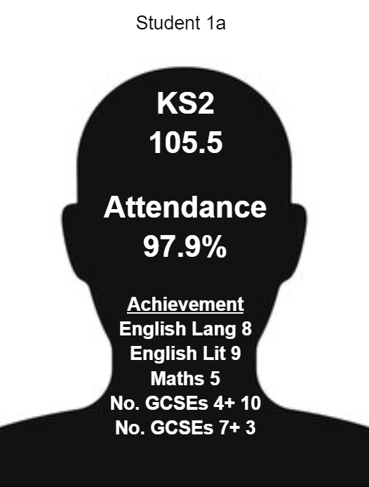
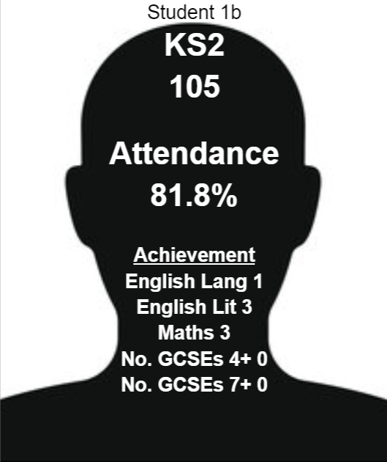
Attendance – ‘every day counts’
King’s Academy Binfield; Dare to be remarkable
Opportunity and Success on a Global Stage
Notes:
GPA

Slide 9
Communication between KAB and parents
King’s Academy Binfield; Dare to be remarkable
ClassCharts - can track attendance and behaviour
Email - reports are sent to parent and student email
Parents evenings with subject staff
Pastoral query - form tutor first
Subject query - subject teacher first
Opportunity and Success on a Global Stage
Notes:
GPA

Slide 10
Parent/carer Involvement
King’s Academy Binfield; Dare to be remarkable
Classcharts will continue to be the main form of communication for behaviour and attendance
Parents Evening - Thursday 9th January and Thursday 5th June
Encouragement to complete homework/revision on a regular basis - more on this in a minute
Encourage them to attend any intervention sessions they are invited to
Communication with school regarding issues/concerns - tutor as first point of contact
Ensuring pupils take time for themselves - hobbies, days out, time spent with family, good sleep and healthy food. Healthy mobile device habits!
Opportunity and Success on a Global Stage
Notes:
GPA

Slide 11
Revision
King’s Academy Binfield; Dare to be remarkable
Start now - revision is not a thing to only be done just before exams
Revising a topic 3 or 4 times across the next two years will be better for retention that once just before the exam
How to revise?
Work out how you best revise now
Teach it
Utilise YouTube & TikTok
Historic exam questions
If you do poorly on a mock exam (PPE), work out why and fix the root problem
Opportunity and Success on a Global Stage
Notes:
JDA
First wave of intervention is the quality first teaching in the classroom. Which we take pride in. We ensure that we have the right students with some of the best teachers for them to succeed. Supporting them to plug gaps as they go along.
Period 7 sessions will commence formally after PPEs in November.

Slide 12

Revision Website
King’s Academy Binfield; Dare to be remarkable
Opportunity and Success on a Global Stage
Notes:
GPA

Slide 13
Why do we do PPEs?
King’s Academy Binfield; Dare to be remarkable
To prepare students for being quiet for a long period of time!
To get into the routines of exams ready for 2025
To understand their current attainment
Core subjects in the sports hall
Opportunity and Success on a Global Stage
Notes:
PPEs stands for Pre Public Examinations.
It reflects that these are sets of exams that are important. They are steps along the way to the final exams. Working hard for them helps with the final results, hence pre public exams, not MOCKs that sounds unimportant.
JDa

Slide 14
Stationary required for exams
King’s Academy Binfield; Dare to be remarkable
Black pens (at minimum x2)
Highlighters x4
Scientific Calculator (preferably a Casio if purchasing a new calculator)
Ruler (preferably with mm scale - not a bendy one!)
Pencil and eraser
Sharpener for pencil
Protractor
Pair of compasses (with a pencil that fits it)
Clear pencil case
Opportunity and Success on a Global Stage
Notes:
GPA

Slide 15
Year 10 PPEs
King’s Academy Binfield; Dare to be remarkable
Two sets of formal mock exams will take place
Winter: Monday 18th November - Thursday 28th November
Spring: Tuesday 22nd April - Thursday 1st May
Opportunity and Success on a Global Stage
Notes:
GPA

Slide 16
Reporting points - 24/25
King’s Academy Binfield; Dare to be remarkable
Three reports over the course of the year reflecting progress in learning.
Reports will contain:
Assessment percentage
Assessment grade
Professional predicted grade - teachers’ professional judgement of possible final grade
ATL grades - effort and application in lessons and with homework
If these do not match up, ask yourself why
Opportunity and Success on a Global Stage
Notes:
GPA

Slide 17
CORE SUBJECTS
King’s Academy Binfield; Dare to be remarkable
Opportunity and Success on a Global Stage
Notes:
JDA
First wave of intervention is the quality first teaching in the classroom. Which we take pride in. We ensure that we have the right students with some of the best teachers for them to succeed. Supporting them to plug gaps as they go along.
Period 7 sessions will commence formally after PPEs in November.

Slide 18
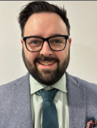
Maths - Mr Johnson-Walker
King’s Academy Binfield; Dare to be remarkable
Students are entered for either Higher or Foundation tier.
Higher tier covers grades 9 to 4
Foundation tier covers grades 5 to 1
Final decision for tiers of entry made in March 2025
All students will take 3 x 1.5 hour exams
Paper 1 is non-calculator
Papers 2 & 3 are calculator
Opportunity and Success on a Global Stage

Slide 19

Maths - Equipment
King’s Academy Binfield; Dare to be remarkable
Ensure you have the correct equipment for EVERY lesson
Black pens, pencil, ruler, protractor, compasses and a scientific calculator
Students need to use their own calculator regularly to familiarise themselves with all the functions.
Statistically students do not perform as well on Paper 2 and 3 as they do on Paper 1 as they are not using this resource regularly.
All students are set Sparx Homework every week; set on a Wednesday and due the following Tuesday
Opportunity and Success on a Global Stage

Slide 20
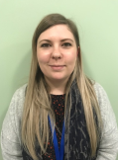
English - Mrs Sebbage
King’s Academy Binfield; Dare to be remarkable
The majority of students will be entered for two GCSEs.
  English Literature - 2 papers
  English Language - 2 papers
  Spoken Language Endorsement
A small number of students will sit the English Language GCSE only (this is based on individual needs)
English Literature | English Language
Paper 1 - 1hr 45 mins Macbeth Jekyll and Hyde | Paper 1 - Fiction 1hr45 1 source 4 questions based on the extract 1 creative writing question
Paper 2 - 2hr 15 mins Section A - An Inspector Calls Section B Power and Conflict Poetry OR Love and Relationships Section C Unseen Poetry | Paper 2 - Non-fiction 1hr45 2 sources 4 questions based on the extracts 1 persuasive writing question
Opportunity and Success on a Global Stage

Slide 21



English - Equipment and homework
King’s Academy Binfield; Dare to be remarkable
All students need a minimum of X2 black pens - the exam specifies a black pen on the front cover of their exams
Copies of the core texts (letters will always be sent out)
Core quotations for Literature must also be learnt
Knowledge tests check progress every fortnight
Anthologies for poetry are provided by AQA
Homework is set on Century
x4 highlighters
Opportunity and Success on a Global Stage
Notes:
JDA

Slide 22
Science - Mr Baldwin
King’s Academy Binfield; Dare to be remarkable
Students study either the AQA Combined Science (trilogy) pathway, or separate sciences. Combined science is awarded as two GCSE grades in “Science”, and the three separate sciences are a grade each.
All students will have six final science exams – two in each subject. The exams are different lengths (see next slide) depending on combined Vs separate
All students study all three sciences, no matter which pathway they take
Students can be on the Higher tier (grade 4-9) or the foundation tier (grade 1-5) on both the combined and separate science pathways
Students must bring full equipment, including a calculator, to all lessons and exams
Opportunity and Success on a Global Stage
Notes:
JBa

Slide 23
Science
King’s Academy Binfield; Dare to be remarkable
Biology Paper 1
1 hr 45, 100 marks
F or H
Chemistry Paper 1
1 hr 45, 100 marks
F or H
Physics Paper 1
1 hr 45, 100 marks
F or H
Biology Paper 1
1 hr 15, 70 marks
F or H
Biology Paper 2
1 hr 15, 70 marks
F or H
Biology Paper 2
1 hr 45, 100 marks
F or H
Chemistry Paper 2
1 hr 45, 100 marks
F or H
Physics Paper 2
1 hr 45, 100 marks
F or H
Chemistry Paper 1
1 hr 15, 70 marks
F or H
Chemistry Paper 2
1 hr 15, 70 marks
F or H
Physics Paper 1
1 hr 15, 70 marks
F or H
Physics Paper 2
1 hr 15, 70 marks
F or H
GCSE BIOLOGY
(1-9)
GCSE CHEMISTRY
(1-9)
GCSE PHYSICS
(1-9)
GCSE COMBINED SCIENCE. 2 Grades from 1-1 → 9-9
Opportunity and Success on a Global Stage
Notes:
JBA

Slide 24
King’s Academy Binfield; Dare to be remarkable
King’s Academy Binfield
Work Experience Y10
Opportunity and Success on a Global Stage
Notes:
JBA
First wave of intervention is the quality first teaching in the classroom. Which we take pride in. We ensure that we have the right students with some of the best teachers for them to succeed. Supporting them to plug gaps as they go along.
Period 7 sessions will commence formally after PPEs in November.

Slide 25


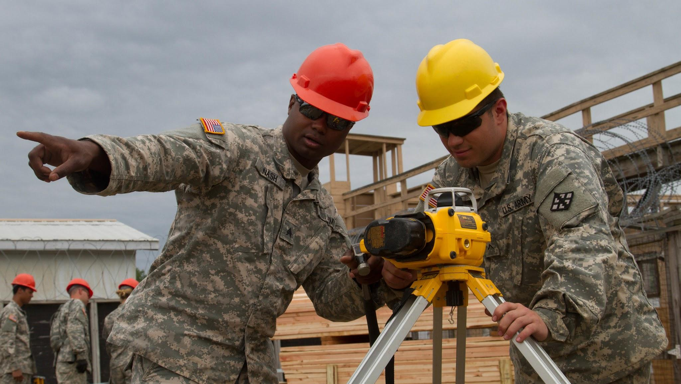
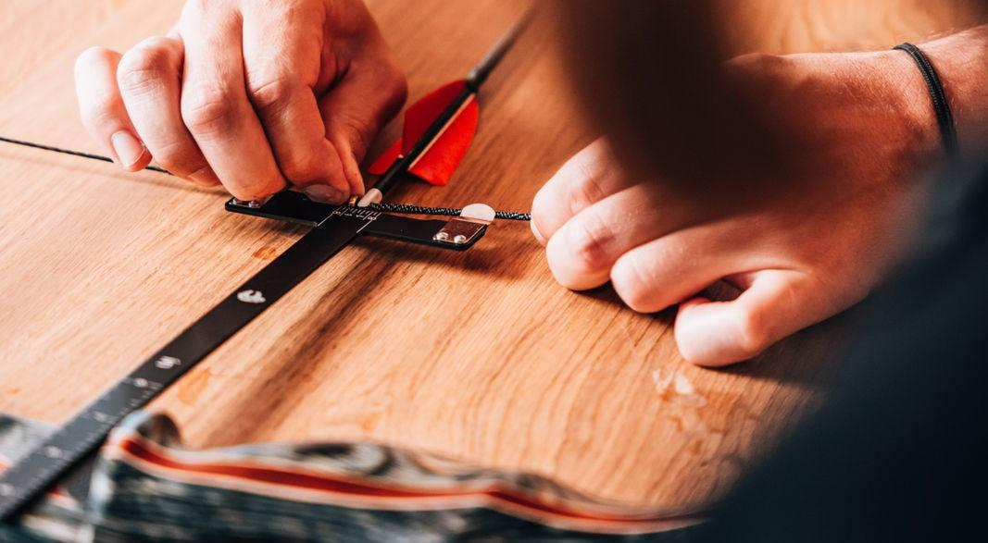
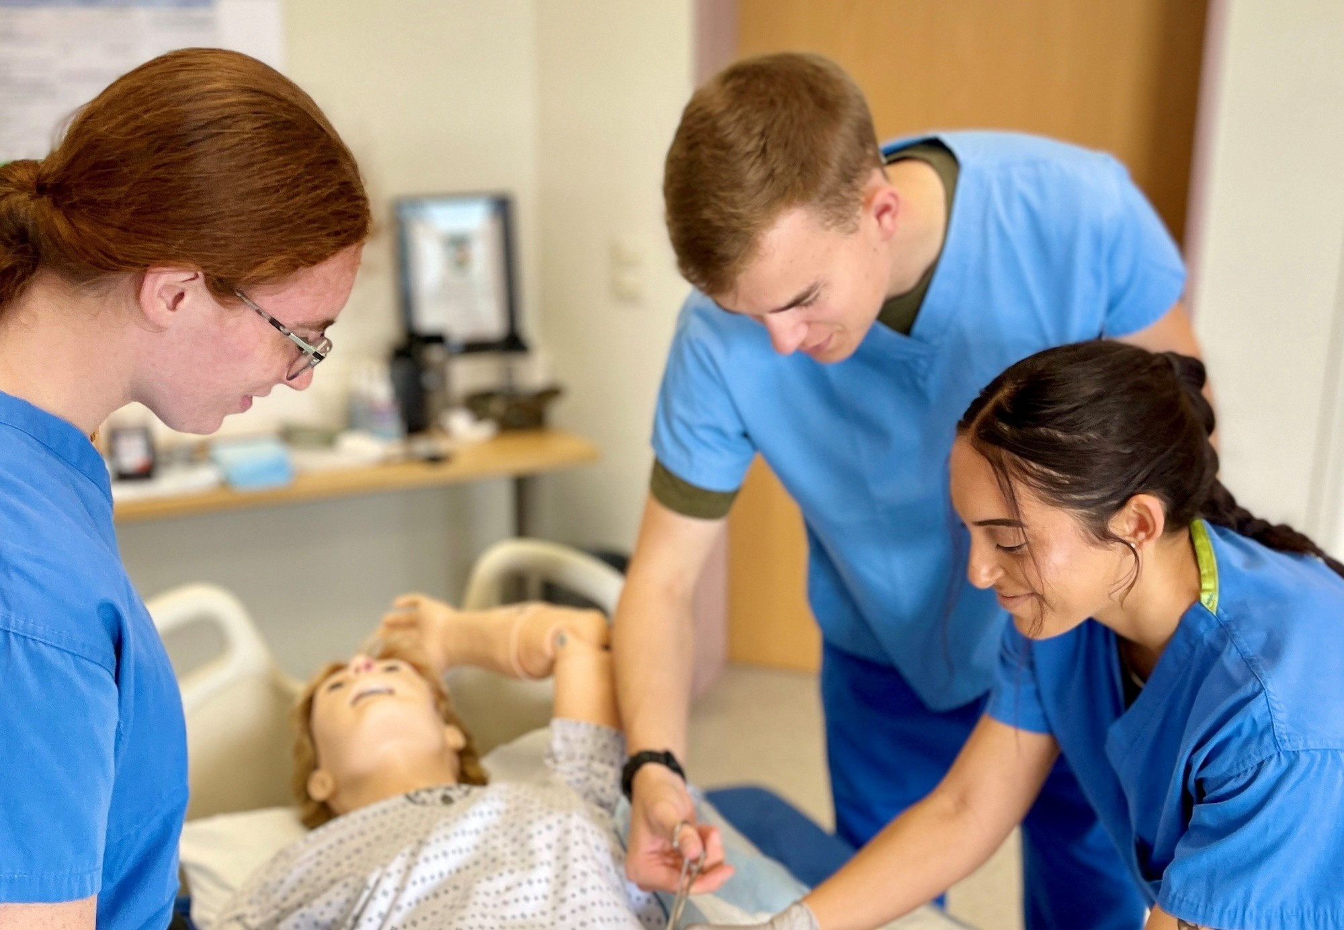



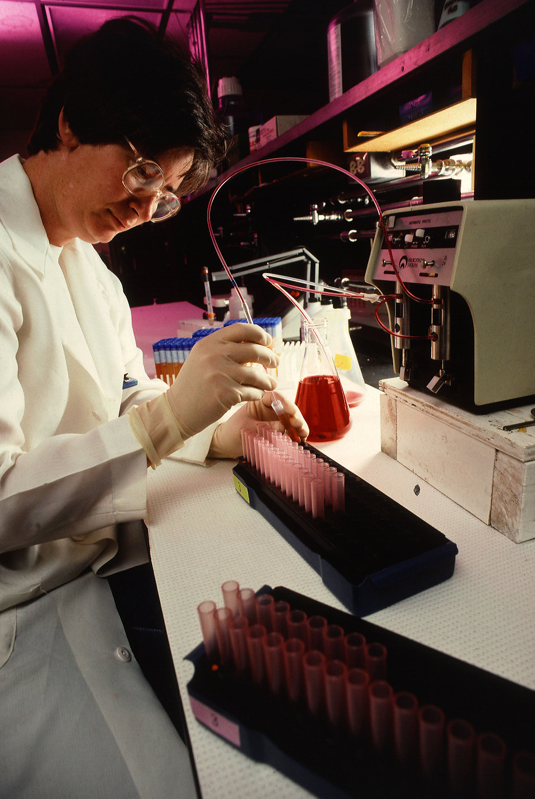
Workplace Experience at KAB
We are launching work experience! The placements will (provisionally) take place on the week beginning 5th May
Students will need to find their own placement in an industry or sector that is relevant for them,
Students will use Unifrog to organise their placement (more on this later)
We can help student, But the onus is on them! We have limited resources and can’t support many.
Students who are unable to secure an in-person placement will be guided through finding appropriate online work experience which they will undertake in school during this time.
Notes:
JBa
W/B 5th of May, monday is a bank holiday. We are exploring the possibility of having a 4 day placement for students, Tuesday → Friday. Last year was 2 days, and its possible it will remain the same this year too.

Slide 26
Supporting activities
The work place experience will not happen in isolation. In the build up to the placements, students will:
Create a CV with guidance from your tutor and input from industry experts
Write an application letter to a real job role
Have a mock interview with a representative from businesses that are supporting us
Get feedback on the whole process

Slide 27
Why have experiences of the workplace
Work experience placements have the potential to be a powerful activity for students to engage with. Positive engagement is linked with a range of positive outcomes, including:
Students find the experience a positive and enjoyable one
Students gain employability skills
Students personal effectiveness improves, including their motivation to succeed in school
Students feel more ready to begin a career
Students have better access to career opportunities in the future and are more able to secure part time employment.

Slide 28

Using Unifrog
This guide talks through how to use the unifrog placements tool.
A letter will be sent out shortly with lots more useful links and information.
you will need to select the “careers.bi@kingsacademies.uk” for their placement co-ordinator which will come through to the careers team
When these slides are shared with you, you will be able to rewatch this as and when is necessary so that you are confident on the process that you need to follow

