Slide 1

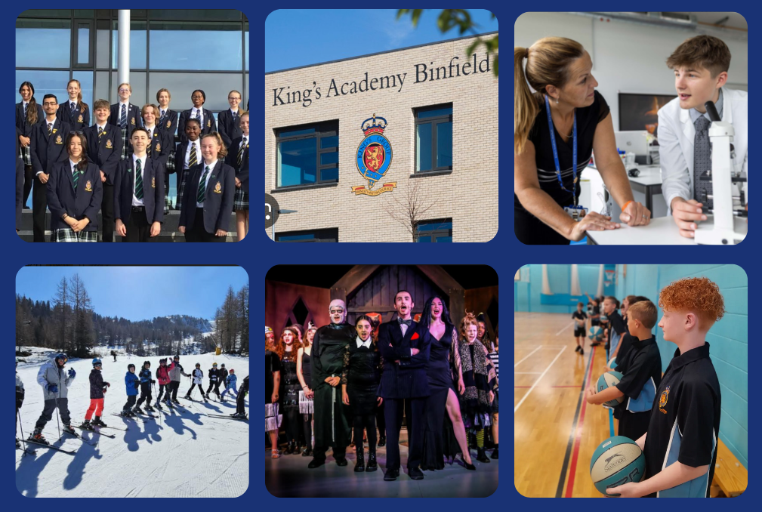

Welcome To King’s Academy Binfield
King’s Academy Binfield; Dare to be remarkable
Welcome to
King’s Academy Binfield
Opportunity and Success on a Global Stage
Notes:
SBn - Welcome Year 9 GCSE Options Evening

Slide 2
Welcome To King’s Academy Binfield
King’s Academy Binfield; Dare to be remarkable
Introduction
Welcome to the Year 9 GCSE Options Evening
Receive lots of information tonight
Picking a pathway that is right for you
Ask lots of questions
Here to support you
Opportunity and Success on a Global Stage
Notes:
SBn
Focus of the evening to support your child in making decision about their GCSE options
Lots of staff here, specialist teachers, Mrs Theobalds YPL, Senior Leadership Team, SEN, etc
Receive lots of information about GCSEs/BTECS/Vocational Qualifications
Ensure that everyone has a breadth of options for Post 16 and has the opportunity to achieve the best they possibly can
Important that you ask lots of questions, all of the staff are keen to support

Slide 3

Welcome To King’s Academy Binfield
King’s Academy Binfield; Dare to be remarkable
Time for an Important Decision
40% of their timetable for the next 2 years
Make sure that they have all the information before making choices
Been encouraged to discuss their options with you
Ensure choices made allow all pathways in the future remain available
Opportunity and Success on a Global Stage
Notes:
SBn - Opportunity to now select 40% of their timetable for the next 2 years
Each subject has set up an information stand here tonight
Copy of the Options Booklets sent to you and available on the website
Important to discuss at home, in school, with teachers at the upcoming parents evening

Slide 4
Welcome To King’s Academy Binfield
King’s Academy Binfield; Dare to be remarkable
Introduction
We want all students to be able to follow an ambitious curriculum that is both broad and balanced through a combination of academic, creative and practical subjects, that best meets their individual learning needs
Therefore, each student has been allocated one of 2 pathways based upon the subjects they have completed across Key Stage 3
Opportunity and Success on a Global Stage
Notes:
SBN
Broad and Balanced Curriculum
Students allocated 1 of two pathways at the moment, which is our recommendation based on Key Stage 2, Key Stage 3 results, performance in class, whether students do a language, if they receive additional support from SEN, etc.

Slide 5
Welcome To King’s Academy Binfield
King’s Academy Binfield; Dare to be remarkable
Types of Qualification
GCSE’s
Majority of grade awarded is based upon performance in final exams at end of Year 11​
Practical subjects (Art, PE, Technology) have practical component which is worth up to 40 percent ​
Grades are 9 (highest) - 1 (lowest)
Some subjects are tiered Higher 5-9, Foundation 1-5 (Maths, Science and MFL)
Vocational (BTEC, WJEC)
Majority (but not all) of the grade is based upon independent coursework
Coursework is marked internally by your teachers​
Smaller exams to be completed during the course​
Opportunity and Success on a Global Stage
Notes:
SBn
Two main types of qualification going to discuss this evening
GCSE
Vocational
Some subjects have to do (Core GCSE subjects)
Different types of learning style and think about how each course is structured/assessed

Slide 6

Welcome To King’s Academy Binfield
King’s Academy Binfield; Dare to be remarkable
The English Baccalaureate
The EBacc is a set of subjects at GCSE that keeps young people’s options open for further study and future careers.
Subjects:
English Literature and Language
Maths
Sciences
History or Geography
Language (French or Spanish)
These subjects are considered essential to many degrees and open doors to a range of careers
Opportunity and Success on a Global Stage
Notes:
SBn
English Baccalaureate - set of subjects
All students take English, Maths and Science subjects
Majority of our students to continue their studies and take a language (French or Spanish)
Pick a Humanities subject - Geography or History
This range of subjects are considered essential to many university courses, degree apprenticeships, apprenticeships. college courses etc.
Keep as many options open for students in the future.

Slide 7

Welcome To King’s Academy Binfield
King’s Academy Binfield; Dare to be remarkable
What will our students study?
Examined
Mathematics
English Literature
English Language
Science (Combined or Separate)
  Physics
  Chemistry
  Biology
Non - Examined
Core PE
PD/PSHE
Religion & World Views
Opportunity and Success on a Global Stage
Notes:
CTh

Slide 8


Welcome To King’s Academy Binfield
King’s Academy Binfield; Dare to be remarkable
What will our students study?
EBacc and Options
Languages
GCSE French
GCSE Spanish
Humanities
GCSE History
GCSE Geography
Opportunity and Success on a Global Stage
Notes:
CTh

Slide 9


Welcome To King’s Academy Binfield
King’s Academy Binfield; Dare to be remarkable
What will our students study?
Arts
GCSE Art & Design - Fine Art
GCSE Art & Design - Textiles
GCSE Art & Design - Photography
GCSE Drama
GCSE Dance
GCSE Music
Technology
GCSE Design & Technology
GCSE Computing
GCSE Food Preparation & Nutrition
Opportunity and Success on a Global Stage
Notes:
CTh

Slide 10

Welcome To King’s Academy Binfield
King’s Academy Binfield; Dare to be remarkable
What will our students study?
Specialist
GCSE Business Studies
GCSE Physical Education
GCSE Media
GCSE Statistics and Further Mathematics
GCSE Religious Studies
Opportunity and Success on a Global Stage
Notes:
CTh

Slide 11

Welcome To King’s Academy Binfield
King’s Academy Binfield; Dare to be remarkable
What will our students study?
Vocational
Princes Trust (now Kings Trust)
Cambridge Technical in IT
BTEC Tech Award (L1/L2) in Performing Arts
BTEC Tech Award (L1/L2) in Enterprise
BTEC Tech Award (L1/L2) in Health and Social Care
OCR Cambridge National in Sports Studies
Opportunity and Success on a Global Stage
Notes:
CTh

Slide 12
Welcome To King’s Academy Binfield
King’s Academy Binfield; Dare to be remarkable
Combination of Subjects
There are some combinations of subjects that you cannot take or that we may suggest against
You only take one technology due to similarity in the courses either Food or Resistant Materials
Recommend you only take one of art, textiles, or photography (Photography and Art are not allowed as a combination)
Recommended that you do not take both a technology and art/textiles due to the considerable amount of coursework throughout the course, especially in year 11
You cannot take both PE GCSE and the OCR Cambridge National in Sports Studies
ALL subjects will be subject to staff resourcing and minimum number of students choosing the option
Opportunity and Success on a Global Stage
Notes:
CTh

Slide 13
Welcome To King’s Academy Binfield
King’s Academy Binfield; Dare to be remarkable
Making the Right Choice
What do you want to do in the future?
What do you enjoy and will work hard at?
What are you making the most progress in and achieving the best grades in?
What is your learning style?
How is the course structured and assessed?
Are you disciplined enough to meet coursework deadlines?
How well do I perform in exams?
Opportunity and Success on a Global Stage
Notes:
CTh

Slide 14
Welcome To King’s Academy Binfield
King’s Academy Binfield; Dare to be remarkable
Do not pick a course because…..
Your friend is doing it
You like the teacher
Opportunity and Success on a Global Stage
Notes:
CTh

Slide 15
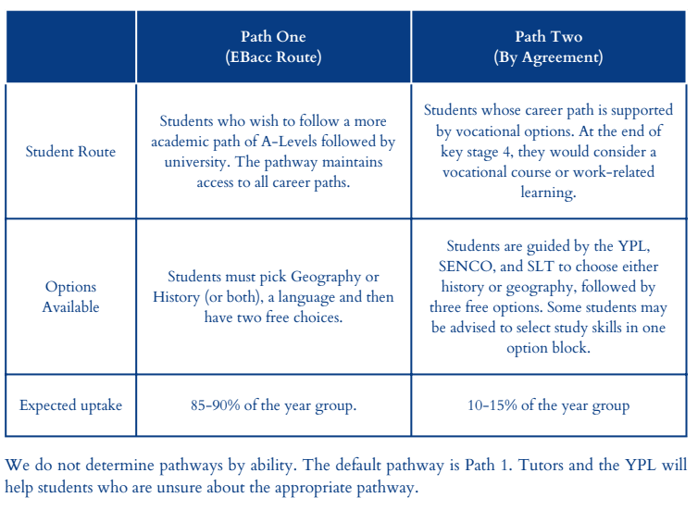
Welcome To King’s Academy Binfield
King’s Academy Binfield; Dare to be remarkable
Pathways
Opportunity and Success on a Global Stage
Notes:
CTh

Slide 16
Welcome To King’s Academy Binfield
King’s Academy Binfield; Dare to be remarkable
Who can you talk to?
Teachers who are here tonight
Subject Teachers - Parents Evening
Your tutor
Your YPL - Mrs Theobalds
Any of the Senior Leadership Team
SENCO & Learning Support Team
Options Surgeries
Parents/Carers
Opportunity and Success on a Global Stage
Notes:
CTh

Slide 17

Welcome To King’s Academy Binfield
King’s Academy Binfield; Dare to be remarkable
Parents Evening
Speak to the subjects that you are considering as GCSE options as a priority
Some subjects will have to prioritise students who are going to continue with the subject at GCSE if capacity is an issue
Read the Options Booklet beforehand so you can ask questions about the course
Reports will be issued shortly along with a link to make online appointments.
Opportunity and Success on a Global Stage
Notes:
CTh

Slide 18
Welcome To King’s Academy Binfield
King’s Academy Binfield; Dare to be remarkable
FAQs
How will I know whether I am doing combined or separate science?
Will I definitely get my top two choices?
Will all the options run?
Can I change my mind?
Will I be able to drop courses during Years 10 and 11?
Who organises the process?
Where can I find all the information?
  Options Booklet
  Website
Opportunity and Success on a Global Stage
Notes:
SBn

Slide 19

Welcome To King’s Academy Binfield
King’s Academy Binfield; Dare to be remarkable
Key Dates
Dec 2024
23 Jan 25
7 Feb 25
Letter to start the options process
Y9 Parents Evening
Deadline for Option Preferences
Options Evening
Option Surgeries
Preferences will be confirmed
16 Jan 25
Early Feb 25
Summer Term
Opportunity and Success on a Global Stage
Notes:
SBn

Slide 20

Welcome To King’s Academy Binfield
King’s Academy Binfield; Dare to be remarkable
What now?
Speak to the teachers
Ask lots of questions
Opportunity and Success on a Global Stage
Notes:
SBn

