Slide 1

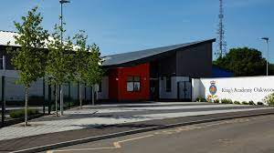
King’s Academy Binfield and
King’s Academy Oakwood
Reception Classes 2026-2027
Notes:
KAL

Slide 2
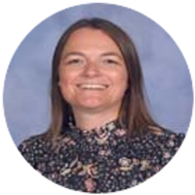
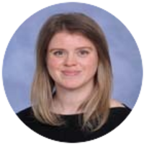
Welcome from…….
Jacqueline Tate - Head of Primary
Naomi Mederson - EYFS Lead and teacher
Kerri-Anne Leavy - Executive Principal
Helen Kenney- Deputy Head
Notes:
KAL

Slide 3

King’s Group Academies
Honesty, Faith and Courage
Opportunity and success on a global stage

Slide 4
Key Staff
ELSA/FSW - Mrs Bateman at KAB and Miss Barker/ Miss Scully at KAO
Attendance and welfare officer - Mrs Vitu
Mrs Evans and Miss McGough - admin staff at KAB
Mrs Pottinger - admin staff at KAO
Cover teachers: Mr Rumble, Mrs Mahoney - KAB
Miss Bond - KAO
Mr Fisher - PE coach KAB and KAO
Notes:
KAL

Slide 5


At KAB we have two reception classes. Your child will be in either:
Emerald Class or Jade Class
Notes:
KAL

Slide 6
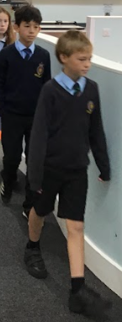
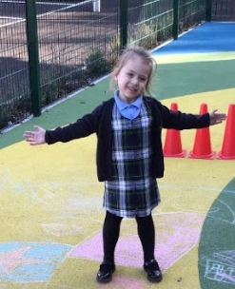
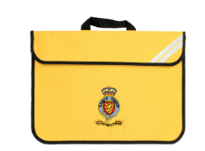

Uniform
Notes:
Both schools the same except for polo/shirt colour
(KAB – white, KAO – powder blue)
Tartan pinafore, embroidered cardigan or jumper from Stevensons – no others permitted
Plain polo shirt, black trousers/shorts
PE kit- King’s navy polo shirt and option sweatshirt from Stevensons
Plain navy shorts, and optional plain navy joggers.
Jewellery – one single, round, plain silver/gold stud only
Will morph into secondary uniform as students progress through the school. Shirts and ties from year 3.

Slide 7
School Timings
Core primary school hours: 8.45am – 3.30pm
(Flexible drop-off from 8.30am)
Wrap around care 7.30am – 6.00pm
After school clubs 3.30pm – 4.30pm
First day of term - Wednesday 2nd September
September 2nd - settling session (am or pm)
September 3rd and beyond – all day
Notes:
JT

Slide 8
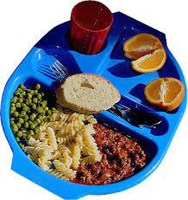
School Lunch
All children in Reception, Year 1 and Year 2 are entitled to a meal, free of charge, under the Universal Free School Meal programme.
The menu will be published in advance and parents will be required to select meals a week in advance.
Notes:
JT

Slide 9


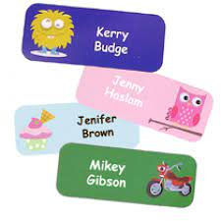



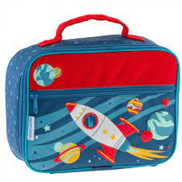
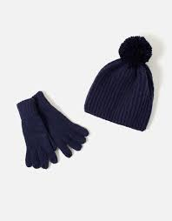

Important Information
Notes:
JT

Slide 10
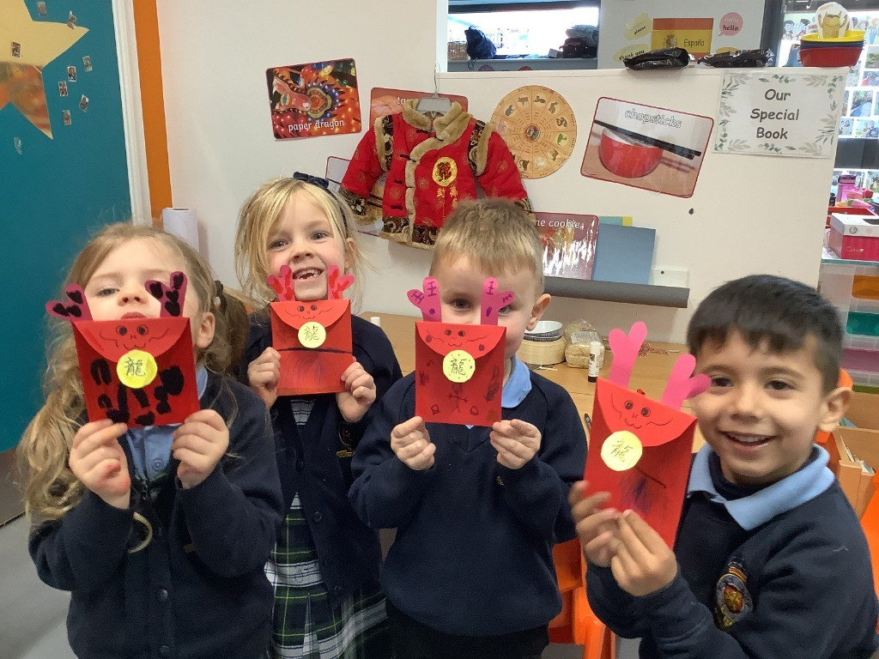
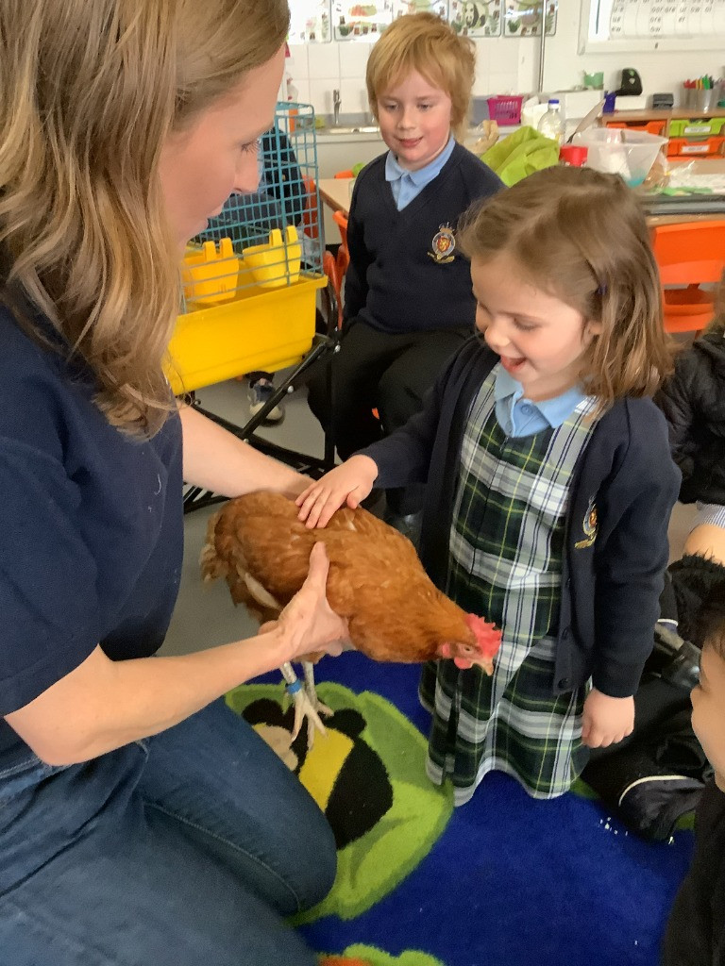
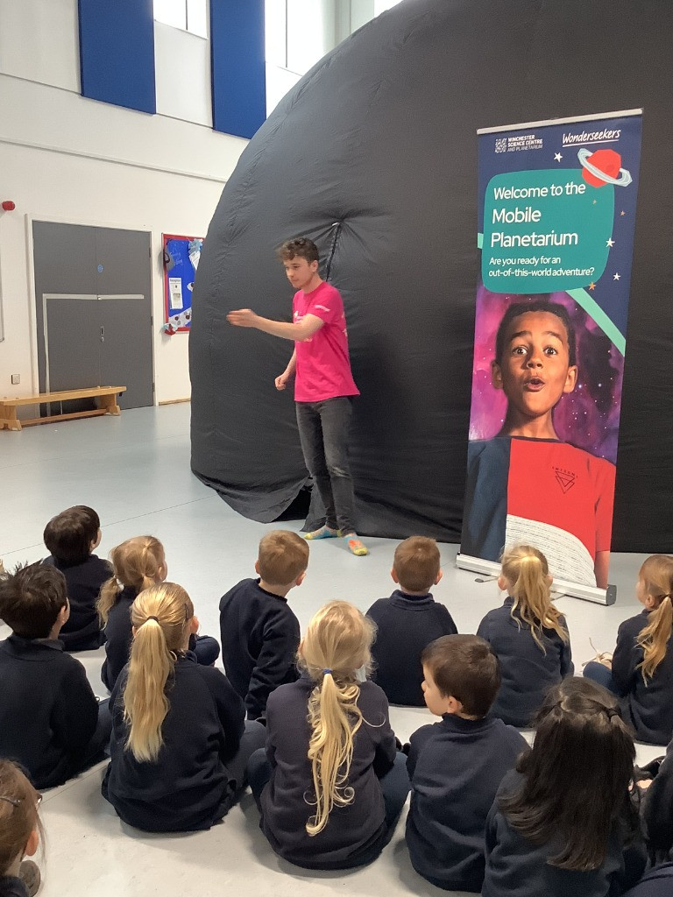
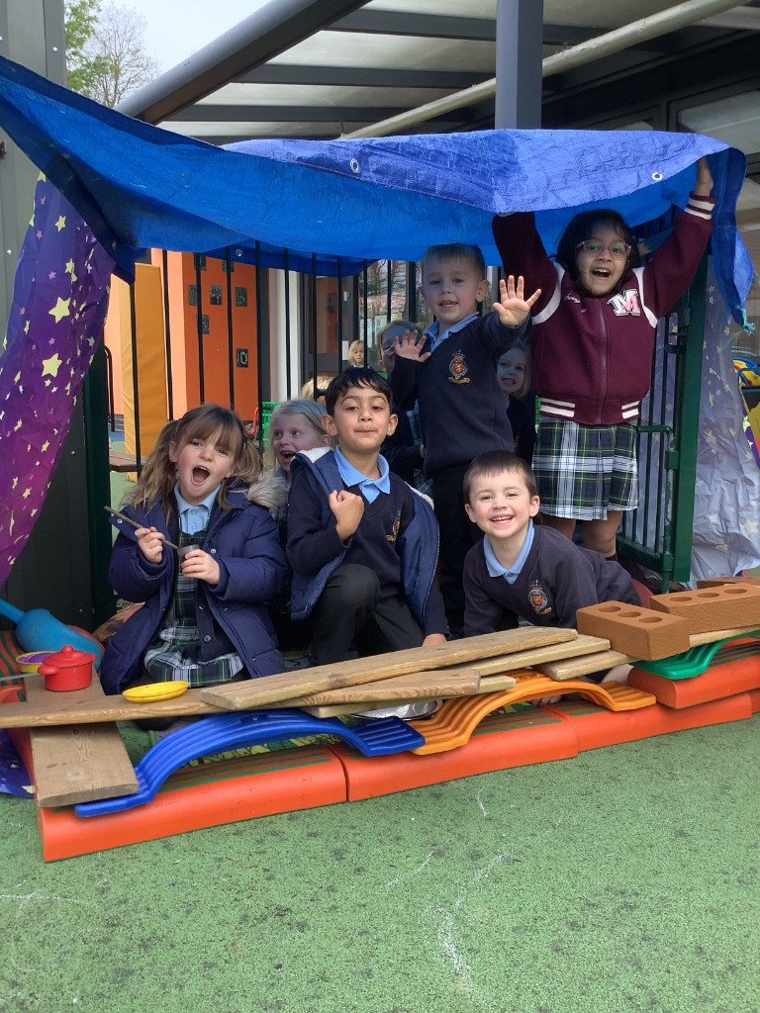
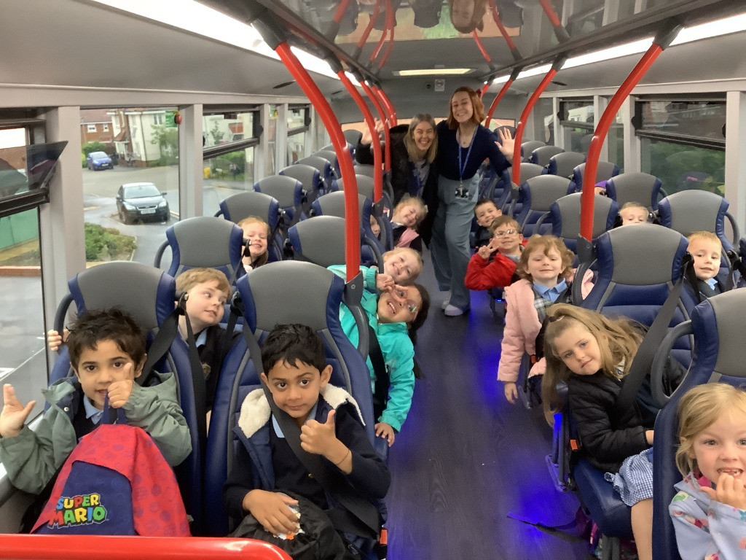
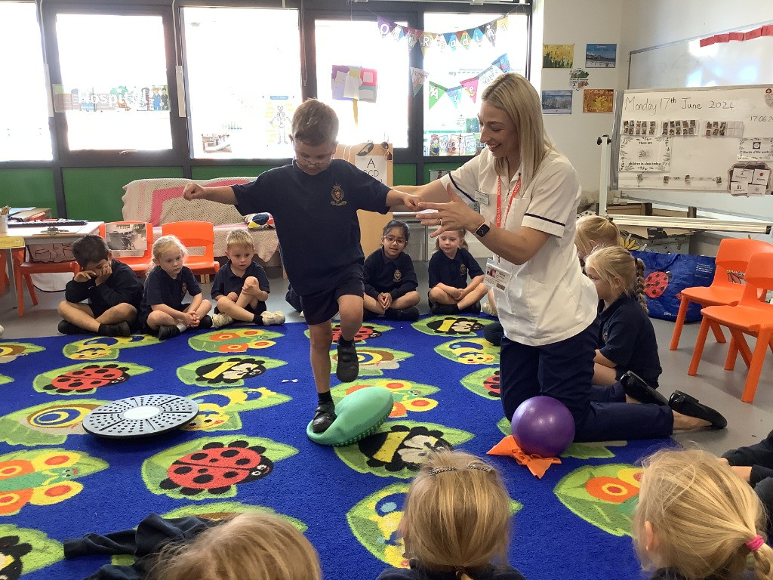
Notes:
NM- wonderful to do all the home visits and meet your children, families, pets etc. Great to see the children so excited to come to school an hope that home visit/our stay and play will help aid the transition . Thought I’d show you some photos of the fun we have! From celebrationg lunar new year, meeting some little red henss, having a visit from a mobile planetarium our eyfs year is jam packed with so much learning and fun. We welcome any visitors with opern arms- if you would like to come and share your job, culture, religion, talent or skill we would welcome you!

Slide 11
A Typical Day in Reception!
Flexible drop off and morning activities
Wake and shake
RWInc Phonics and handwriting
Discovery Time and adult led groups
Snack and milk
Tidy up time
Carpet Input
Lunchtime
Story Time
Discovery Time and adult led groups
PE/Spanish/Library time/Enrichment session
Trim trail time
Rex the Retriever Time
Hometime
Notes:
NM- lots of you asking about a typical day in reception! We have busy days. PLay is an integral part of our day in EYFS (called discovery time). It’s how children explore, make sense of the world and develop those early foundational skills. Alongside that, we also have carefully planned adult‑led activities that introduce new learning, model language and support progression. It’s that balance — rich, purposeful play and high‑quality adult interactions and input — that helps our children thrive.”
We will have a reception event in the Autumn term where we talk to you more about life in Receptio, even more logistical things and how we teach reading and handwriting so look out for that date when year begins

Slide 12
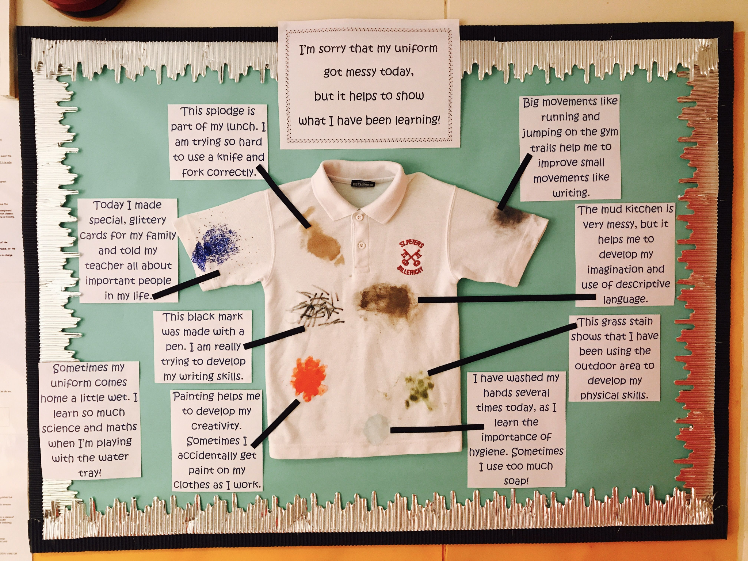
Notes:
We try and protect our uniforms as much as possible with aprons/puddle suits etc but I always like to give a caveat parents that“We do everything we can to protect the children’s uniforms, but EYFS is a very hands‑on, exploratory environment. The children learn best when they’re fully involved — painting, digging, water play, outdoor learning — and sometimes that means clothes will get a bit mucky. Cheaper polo shirts now an option!
NM + wellies and spare clothes

Slide 13

Notes:
NM-
We use an online learning journey called Tapestry to record the children’s learning. Your child’s current setting may already use this or something similar. It allows us to capture photos, videos and observations from school so you can see what your child has been exploring and achieving. It’s a lovely window into their day. Please note this is not daily- and we would rather be interactign with your child rather than using an ipad.
You can also upload from home — things like weekend adventures, special moments, or anything your child is proud of. This helps us build a really rich picture of their learning, both in school and beyond, and strengthens that partnership between home and EYFS.
we also do parents evenings x 2 a year, open door at drop off, report at the end of the academic year

Slide 14
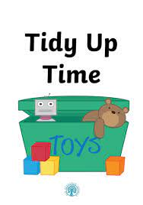
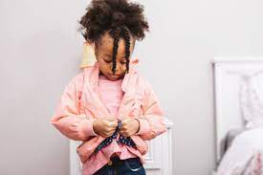

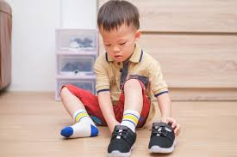
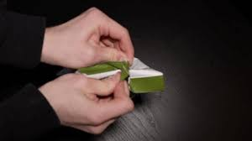
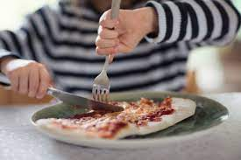
How can you help your child to be ready for School?
Notes:
NM- The best way to prepare your child for Reception is to build their confidence, excitement and independence. Practise simple skills like putting on their coat, using the toilet, opening their lunchbox and packet within it, and tidying up- brain buddy, boss. Most importantly, help them feel safe, happy and excited about school — that’s what makes the biggest difference. Build familiarity with the school and their teachers- we will send booklet out with photos/info about teacher

Slide 15

Stay and Play session- Thursday 25th June 3.45-4.30pm
Transition day- Thursday 2nd July 9-11am (Apil-August) or 1-3pm (Sept-March)
Notes:
NM- talk about stay and play and transition day.
We are really looking forward to your children starting their school journey with us

Slide 16
Thank you for listening!
admin.oakwood@kingsacademies.uk
admin.biprimary@kingsacademies.uk
Notes:
JT

