Slide 1

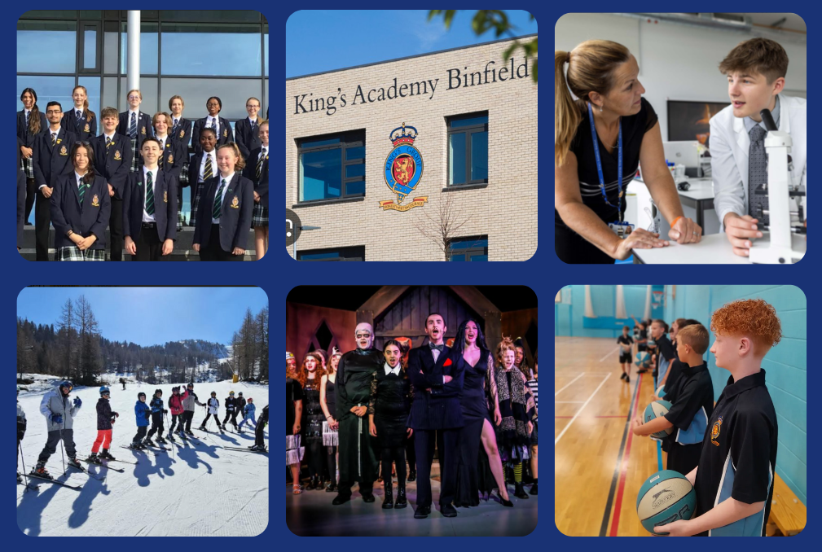
Welcome To King’s Academy Binfield
King’s Academy Binfield; Dare to be remarkable
Welcome to
King’s Academy Binfield
Opportunity and Success on a Global Stage
Notes:
KAL

Slide 2
Welcome To King’s Academy Binfield
King’s Academy Binfield; Dare to be remarkable
Our Academy
Vision
Opportunity and Success on a Global Stage
Values
Honesty | Faith | Courage
Opportunity and Success on a Global Stage
Notes:
KAL

Slide 3
Welcome To King’s Academy Binfield
King’s Academy Binfield; Dare to be remarkable
Introductions
Miss Leavy | Executive Principal
Mrs Taylor | Vice Principal
Mrs Jackson | Year Progress Lead
Opportunity and Success on a Global Stage
Notes:
KAL

Slide 4
Welcome To King’s Academy Binfield
King’s Academy Binfield; Dare to be remarkable
The Year 7 Tutor team
7CU - Miss Newland
7WI - Mr Smith
7CH - Mr Reed
7FL - Miss Mathews
7NI - Dr Hunter
7NE - Miss Zou
7MN - Mrs Barnett
Curie
Churchill
Nightingale
Mandela
The Y7 will be in House tutor groups throughout their time at KAB.
Opportunity and Success on a Global Stage
Notes:
AJa

Slide 5
Welcome To King’s Academy Binfield
King’s Academy Binfield; Dare to be remarkable
The Role of the
Form Tutor and the YPL
First point of contact for you and your child
To support, guide and challenge
Monitor attendance
Monitor behaviour
Monitor progress and attainment
Opportunity and Success on a Global Stage
Notes:
AJa

Slide 6

Welcome To King’s Academy Binfield
King’s Academy Binfield; Dare to be remarkable
Our House points
Aim to give out house points at a ratio of 10:1 house to behaviour points
One +3 student of the lesson every lesson!
Opportunity and Success on a Global Stage
Notes:
LTa

Slide 7

Welcome To King’s Academy Binfield
King’s Academy Binfield; Dare to be remarkable
Our Remarkable Routines
Opportunity and Success on a Global Stage
Notes:
LTa

Slide 8

Welcome To King’s Academy Binfield
King’s Academy Binfield; Dare to be remarkable
Our Remarkable Routines
Opportunity and Success on a Global Stage
Notes:
LTa
Example of our RR for moving around school - common sense and essential so students can move around calmly and safely

Slide 9

Welcome To King’s Academy Binfield
Our Rewards
King’s Academy Binfield; Dare to be remarkable
  House certificates and badges
  House champion award
  Celebration of Success assemblies
  Postcards/Emails/Phone calls home
  Values (Honesty, Faith and Courage) awards
  Reward incentive programmes - Fastrack lunch ticket, breakfast rewards
  YPL awards and reward mornings
  Tutee of the half term
  House champion visit to Golfplex
  Executive Principal Award
  Outstanding contribution Award
Opportunity and Success on a Global Stage
Notes:
LTa

Slide 10





Welcome To King’s Academy Binfield
Our High standards and expectations for all
King’s Academy Binfield; Dare to be remarkable
Clear and consistent
expectations
Please support us
School and home
must work together
Opportunity and Success on a Global Stage
Notes:
LTa

Slide 11

Welcome To King’s Academy Binfield
Our Mobile Phone Policy
King’s Academy Binfield; Dare to be remarkable
Our current policy already meets new government guidance. Mobile phones should be in bags and should not be seen or heard on academy site.
We are currently running a pilot for the collection of mobile phones at the start of the school day.
Any changes to policy will be clearly communicated to all parents/carers.
Opportunity and Success on a Global Stage
Notes:
LTa
Note, a basic phone is preferable for emergencies when travelling to and from school. Thay can’t use it during the day anyway and have no need as they have chromebooks for learning.
With regards to social media, remember, most social media platforms are not allowed until a child is 13 years of age.

Slide 12

Welcome To King’s Academy Binfield
1:1 Devices
Chromebooks
King’s Academy Binfield; Dare to be remarkable
Every student is expected to have access to a device
in all of their lessons
Ways to purchase:
KAB Chromebook Scheme Package - A new Chromebook device, Comprehensive warranty and insurance, Google management licence
Use of already owned chromebook or purchase from the high street. Please note that parents will be required to purchase a Google Management licence to use the device at school.
For families in receipt of Free School Meals, financial support is available to support the cost of the scheme.
Opportunity and Success on a Global Stage
Notes:
AJa

Slide 13
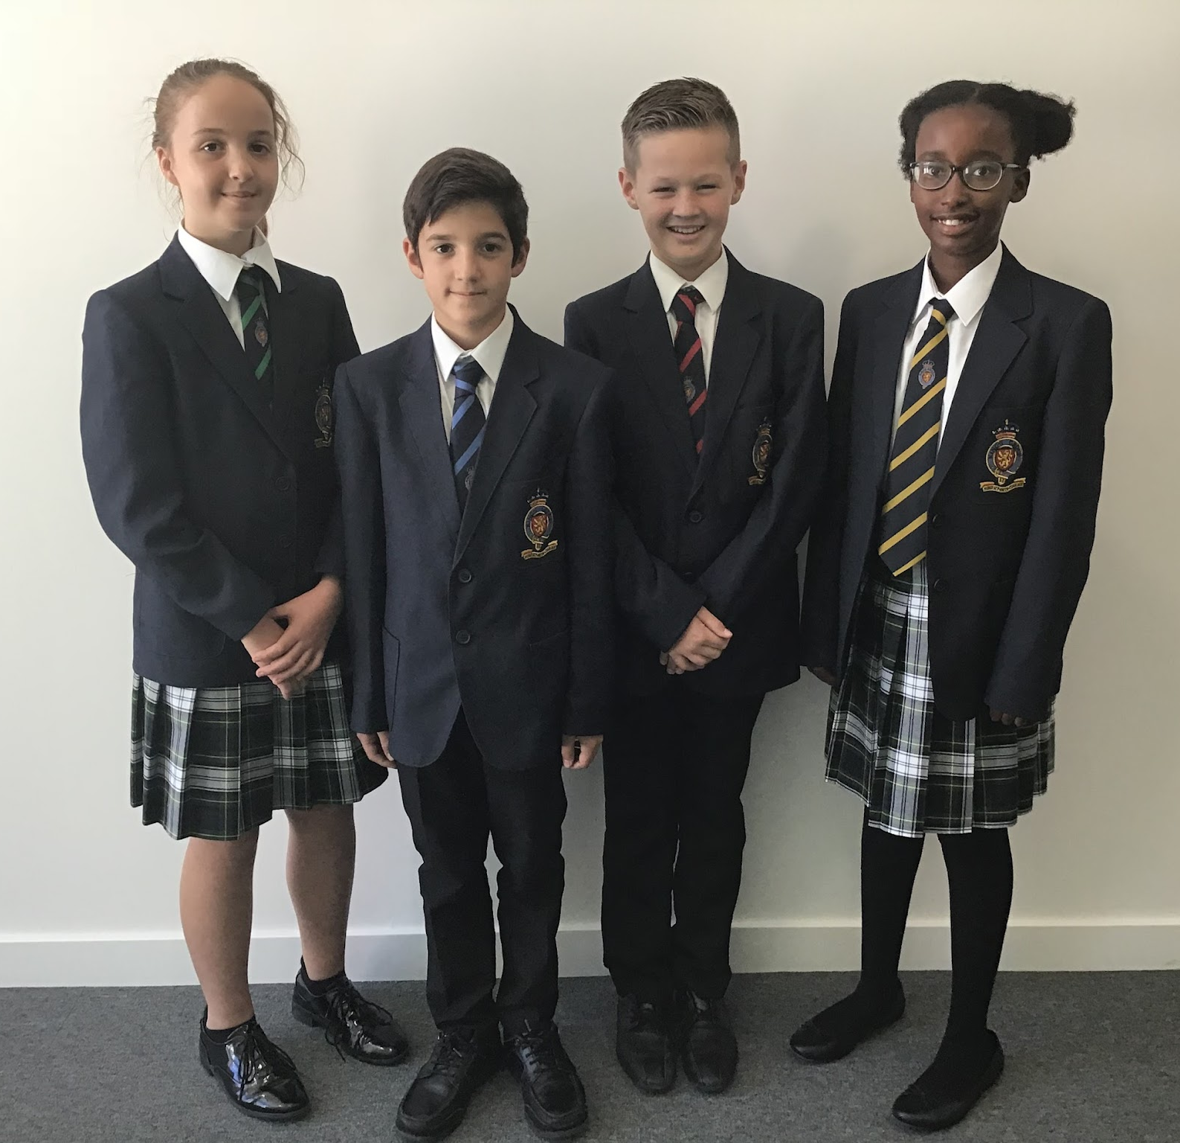
Welcome To King’s Academy Binfield
Our Uniform
Students are expected to wear their uniform correctly at all times exactly as per the policy.
King’s Academy Binfield; Dare to be remarkable
Shirt/tie/blazer is compulsory
Black Trousers or school skirt only
Skirts must be knee length or longer
Plain black shoes which can be polished
Plain black ankle/knee socks or tights
Opportunity and Success on a Global Stage
Notes:
AJa

Slide 14

Welcome To King’s Academy Binfield
King’s Academy Binfield; Dare to be remarkable
Our Uniform Standards
No visible make-up and no nail varnish or false nails
Jewellery – one pair of plain round gold or silver studs to be worn in the lobe of each ear.
School bags must be dark, plain, logo free and large enough to hold A4 folders - not handbags
No smart watches/fitbits may be worn
No outdoor clothing to be worn in the building
No extremes of hairstyle or colour
Shoes - black polishable
(www.stevensons.co.uk)
Opportunity and Success on a Global Stage
Notes:
AJa

Slide 15
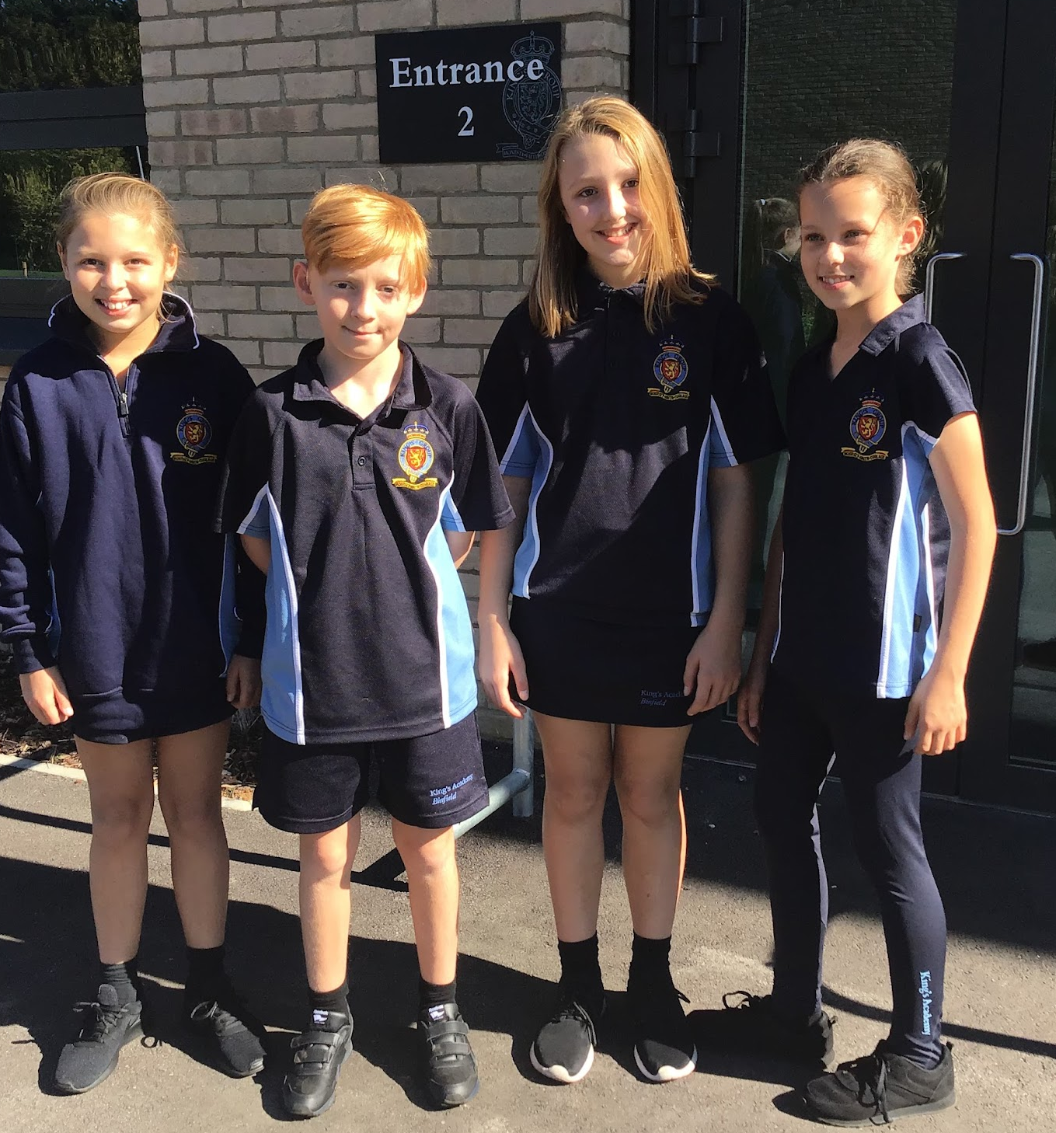
Welcome To King’s Academy Binfield
King’s Academy Binfield; Dare to be remarkable
Our PE Kit
Students will get changed for PE/Dance
Branded T-Shirt
Navy leggings or shorts
Navy zip neck jumper (not a jacket or hoody)
www.stevensons.co.uk
Opportunity and Success on a Global Stage
Notes:
AJa
AJa- please mention that the girls can buy shorts/skorts - Stevensons have been selling shorts as boys only
Also mention that, for SOME classes ONLY ther ebay be days were timetable pressures may mean they have to come to school in their PE kit. Students will be made aware of this if it affects theri class and a letter will go home in September.

Slide 16
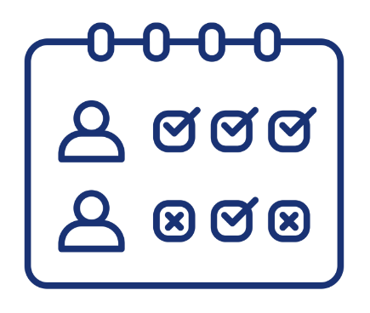
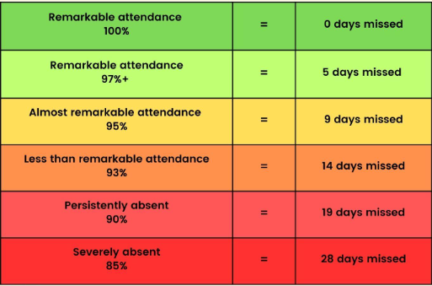
Welcome To King’s Academy Binfield
Attendance Matters
97%+
King’s Academy Binfield; Dare to be remarkable
Opportunity and Success on a Global Stage
Notes:
AJa
AJa- please mention that the girls can buy shorts/skorts - Stevensons have been selling shorts as boys only
Also mention that, for SOME classes ONLY ther ebay be days were timetable pressures may mean they have to come to school in their PE kit. Students will be made aware of this if it affects theri class and a letter will go home in September.

Slide 17
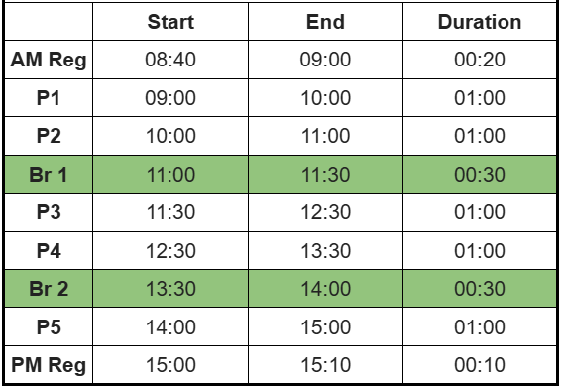

Welcome To King’s Academy Binfield
King’s Academy Binfield; Dare to be remarkable
Timings of our School Day
Opportunity and Success on a Global Stage
Notes:
SBe

Slide 18

Welcome To King’s Academy Binfield
King’s Academy Binfield; Dare to be remarkable
Our Homework
Homework is set online using Google Classroom - you will be registered to sign up to daily or weekly updates
Students will be set homework by core subjects at least once per week and non-core subjects when required
Homework club runs Mon-Fri after school until 4pm
Opportunity and Success on a Global Stage
Notes:
AJa

Slide 19
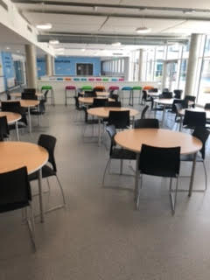
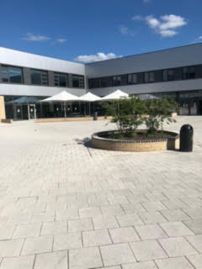
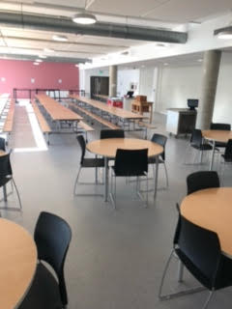
Welcome To King’s Academy Binfield
King’s Academy Binfield; Dare to be remarkable
Our canteen
Students will be able to purchase food in the canteen and snack shack or bring a packed lunch
We use a cashless biometric system and your child has already provided their thumb print
Opportunity and Success on a Global Stage
Notes:
AJa

Slide 20
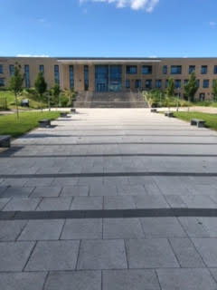
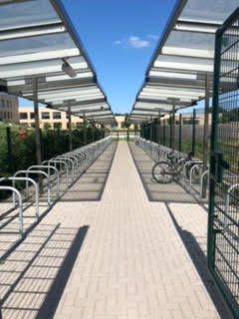
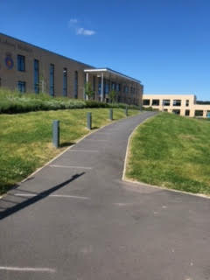
Welcome To King’s Academy Binfield
Your childs first day
Wednesday 2nd September (8.40-12.30)
King’s Academy Binfield; Dare to be remarkable
Students can enter through the Wood Lane entrance or St George’s Park entrance
Students are able to cycle/scoot if they wish but they must have a helmet
Parents must remain in the car park
Opportunity and Success on a Global Stage
Notes:
AJa

Slide 21

Welcome To King’s Academy Binfield
King’s Academy Binfield; Dare to be remarkable
Who do I contact?
If the issue is general or pastoral, you should contact your child’s tutor
If the issue is subject related you should contact your child’s subject teacher
If the issue is related to safeguarding, you should contact our safgeuarding team
Opportunity and Success on a Global Stage
Notes:
AJa

Slide 22

Welcome To King’s Academy Binfield
King’s Academy Binfield; Dare to be remarkable
Dates for your Diary
First Day of Term | 2nd September (8.40 - 12.30)
Year 7 Meet the Tutor | 29th September
Year 7 Settling in Report | 16th October
Year 7 Parents Evening | 10th June
Opportunity and Success on a Global Stage
Notes:
AJa

Slide 23
Welcome To King’s Academy Binfield
Thank you
We look forward to seeing you in September!
King’s Academy Binfield; Dare to be remarkable
Opportunity and Success on a Global Stage
Notes:
KLe

